Slide 1
An Overview of Image Matting
Speaker: Hao Hu
Adviser: Jian-Juin Ding

Slide 2
Bullet Time

Slide 3
Outline
Bullet Time
Traditional Approach of Matting
Bayesian Image Matting
See You Around

Slide 4
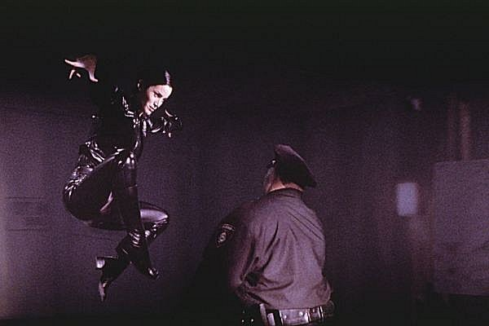
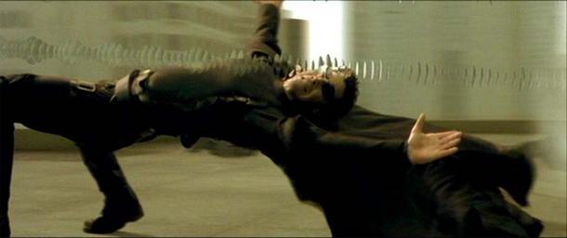
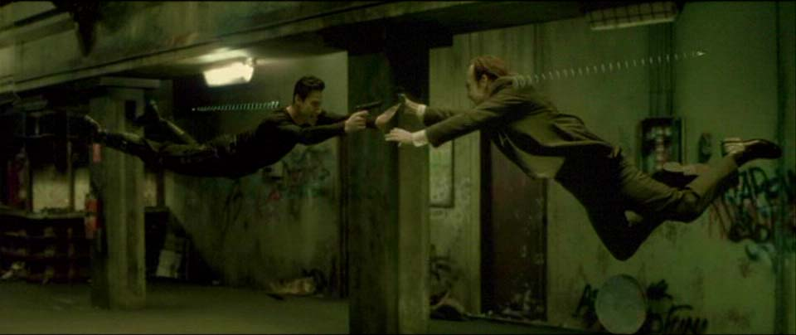
Bullet Time
The Matrix

Slide 5
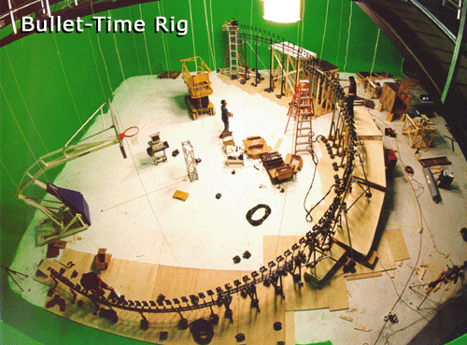
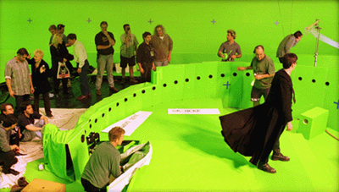
Bullet Time Rig
Green Screen Room
120 cameras

Slide 6
Bullet Time

Slide 7
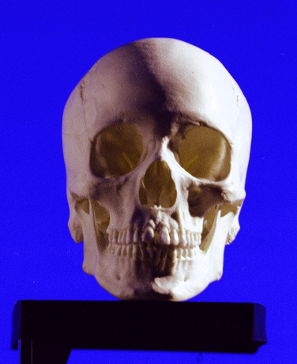
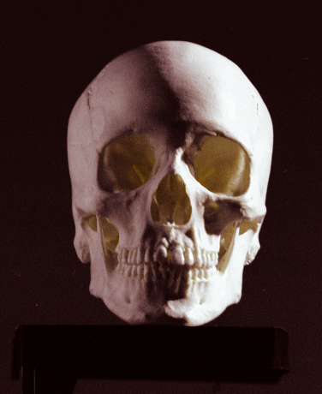
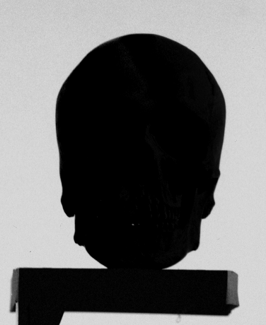
Traditional Approach of Matting : Color Difference Method
Based on RGB color model
if B>G then B=G
α=B – max(G,R)

Slide 8
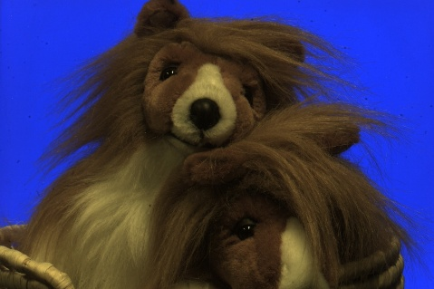
Traditional Approach of Matting : Color Difference Method
C = αF + (1- α)B
C:Composition F:Foreground B:Background
Origin
F
α
C
α=B – max(G,R)

Slide 9
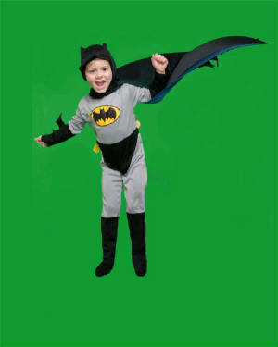
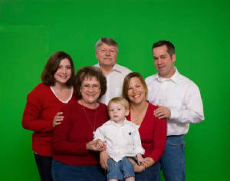
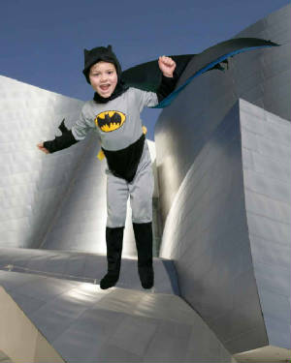
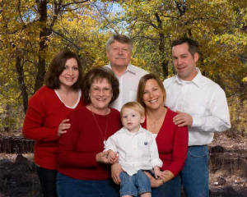
Examples

Slide 10
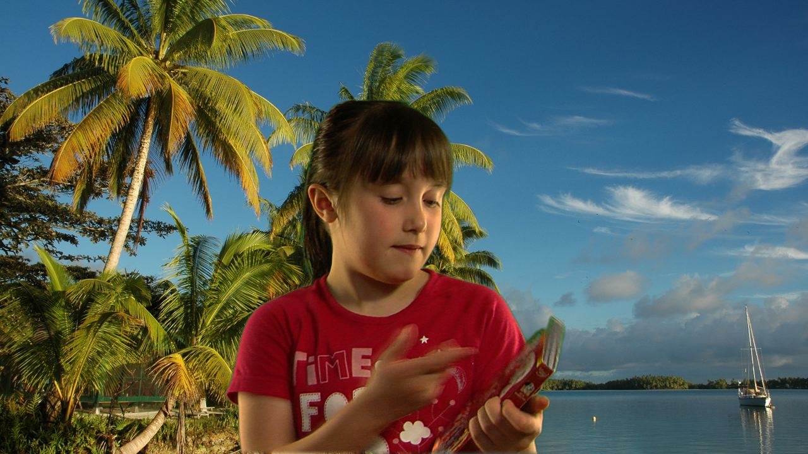
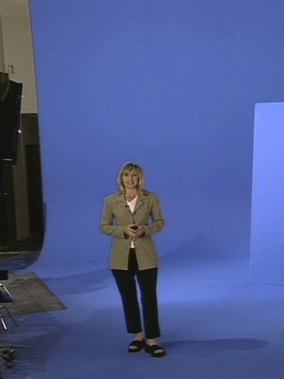
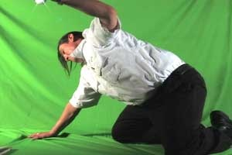
Problems for Blue Screen Matting
Back ground color usually not perfect.

Slide 11
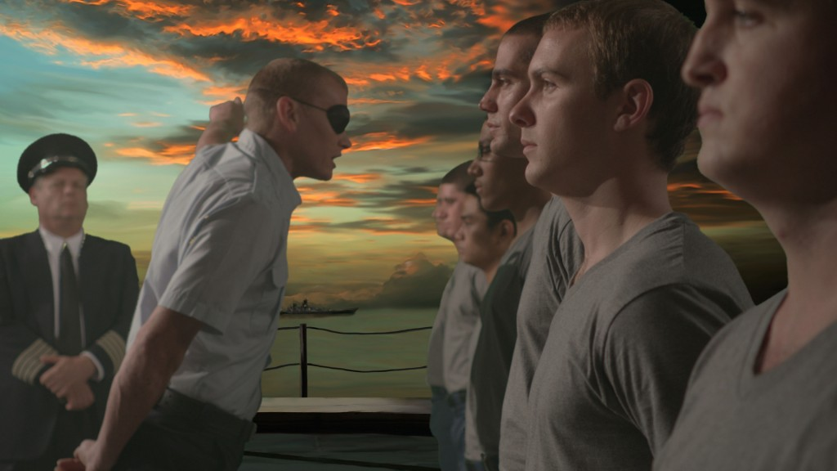
Problems for Color Difference Method

Slide 12
Bayesian Image Matting

Slide 13
Bayesian Image Matting

Slide 14
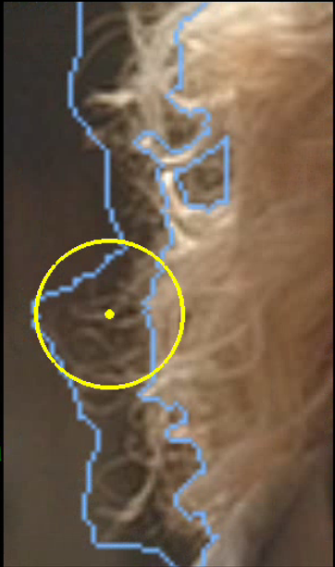
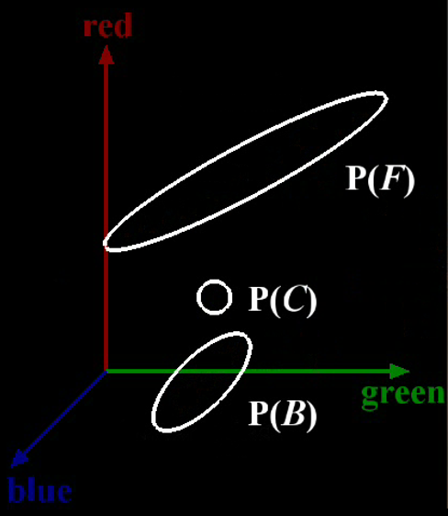
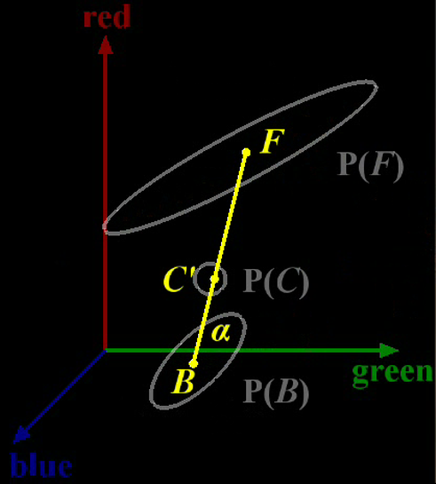
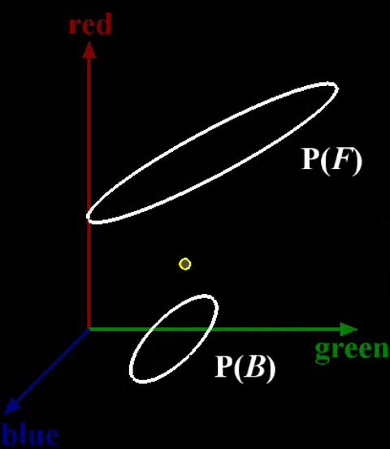
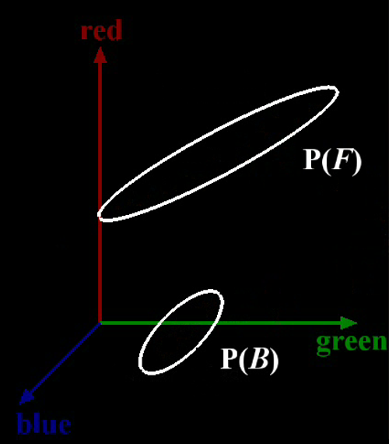
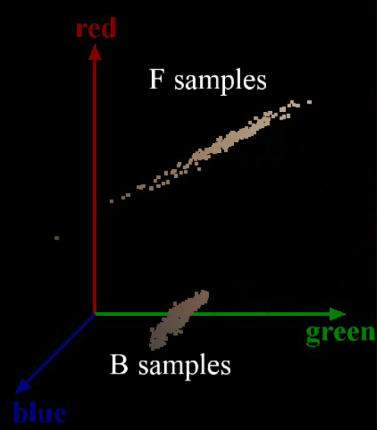
Bayesian Image Matting

Slide 15
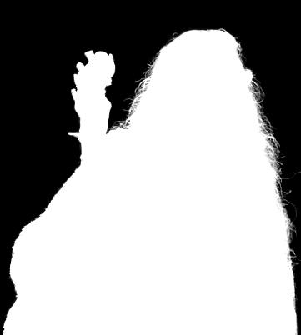
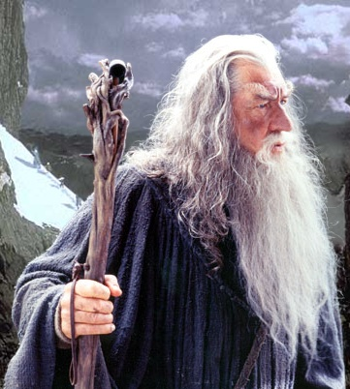
Bayesian Image Matting

Slide 16
See You Around

Slide 17
Thank you

Slide 18
Reference
http://www.csie.ntu.edu.tw/~cyy/courses/vfx/13spring/news/
http://www.youtube.com/watch?v=Rg5dNOPJf-I
http://www.youtube.com/watch?v=bKEcElcTUMk
http://research.microsoft.com/apps/pubs/default.aspx?id=73833

